Slide 1



Beam Direction
$$ℰ_{Stark}$$
$$ℰ_{L2}$$
$$ℰ_{nr}$$
Region 1
Region 2
Region 3

Slide 2
(a)
(b)
(c)

Slide 3
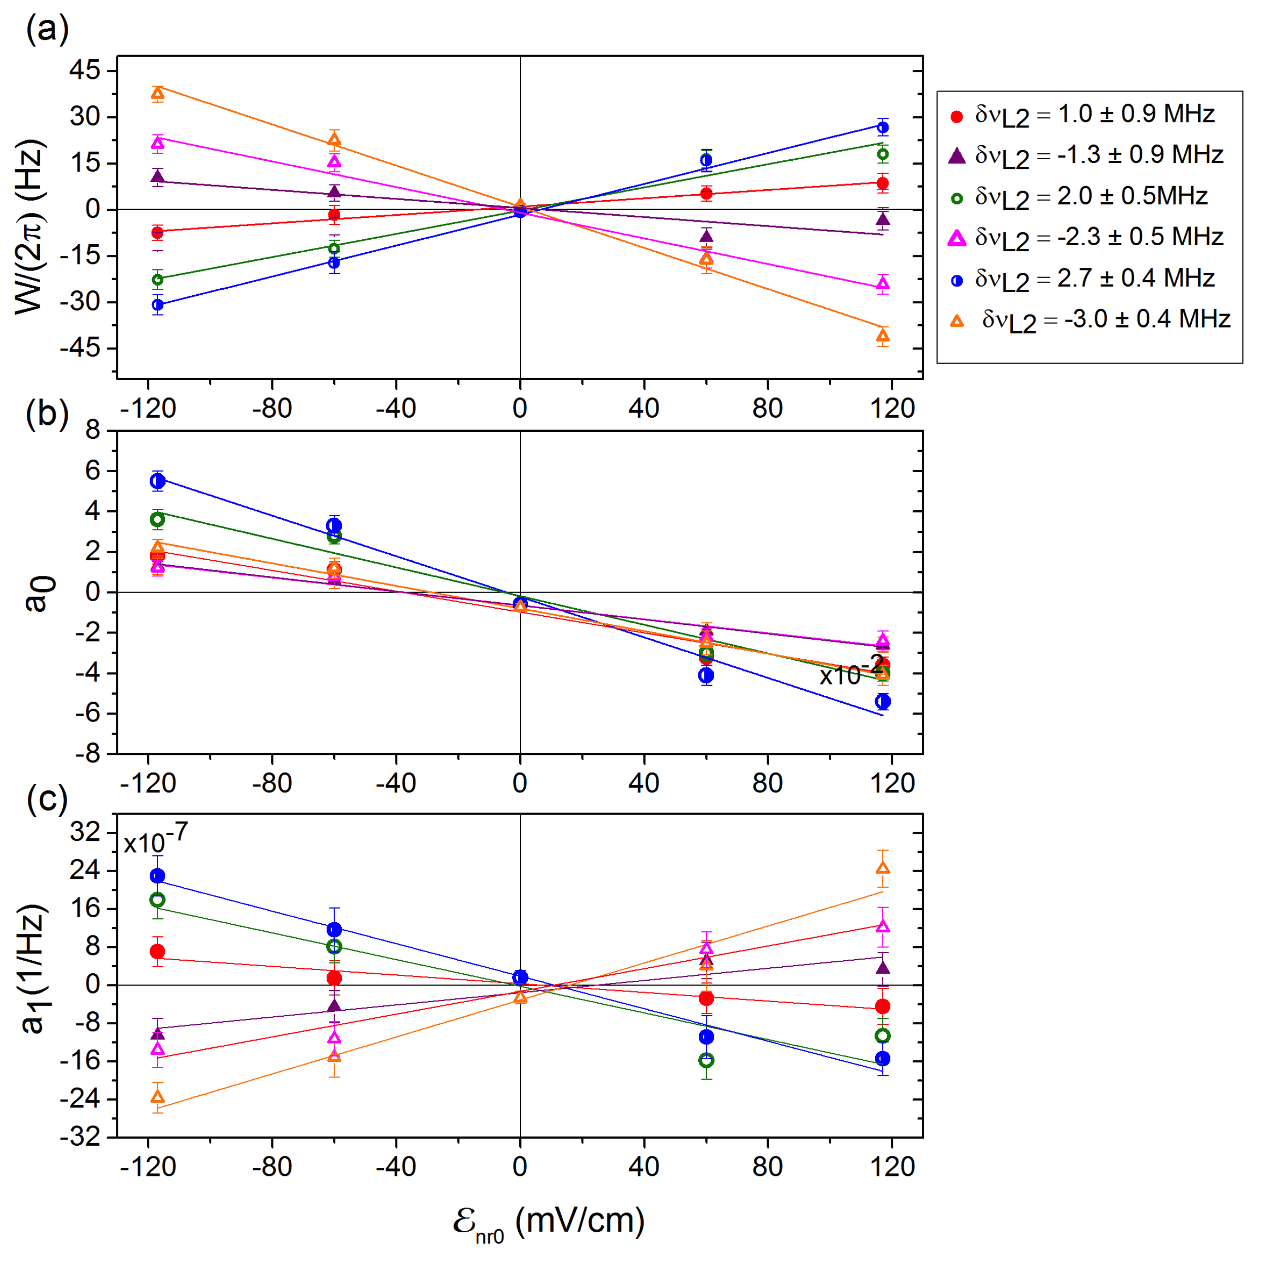
Experiment vs Simulated

Slide 4
Simulated
Analytic
(a)
(b)

Slide 5
(a)
(b)
(c)

Slide 6

Original
Before
After
$W/2π$ [Hz]
(a)
(b)
(c)

Slide 7

Original
Mod
$W/2π$ [Hz]
(a)
(b)

Slide 8

$W/2π$ [Hz]

Slide 9

















$Delta$ 3MHz
$Delta$ 1MHz
$Delta$ 0MHz
$Enr$ 12
$δ_{L2}=$ 0 MHz
$δ_{L2}=$1$×$2$π$MHz
$ℰ_{nr}=$ 12V/m
$δ_{L2}=$ 3$×$2$π$MHz
$ℰ_{nr}=$12V/m
$ℰ_{nr}=$12V/m
$Enr$ 3
$δ_{L2}=$ 0MHz
$ℰ_{nr}=$ 3V/m
$δ_{L2}=$3$×$2$π$MHz
$δ_{L2}=$1$×$2$π$MHz
$ℰ_{nr}=$ 3V/m
$ℰ_{nr}=$ 3V/m

